Slide 1
Big Data and Cloud Computing: Current State and Future Opportunities
EDBT 2011 Tutorial
Divy Agrawal, Sudipto Das, and Amr El Abbadi
Department of Computer Science
University of California at Santa Barbara

Slide 2










Why? WEB is replacing the Desktop
Notes:
As we all know – WEB based services and applications are replacing desktop applications. There are numerous examples – and using my own experience – I guess that more than 50% of my computer interactions involve accessing Web applications.
This trend is not likely to change instead it will continue on this trajectory.
Even for internal and in-house applications – we access them through a Web browser.
So clearly – there is a permanent shift towards service-oriented computing.

Slide 3













Paradigm Shift in Computing

Slide 4
What is Cloud Computing?
Delivering applications and services over the Internet:
Software as a service
Extended to:
Infrastructure as a service: Amazon EC2
Platform as a service: Google AppEngine, Microsoft Azure
Utility Computing: pay-as-you-go computing
Illusion of infinite resources
No up-front cost
Fine-grained billing (e.g. hourly)

Slide 5
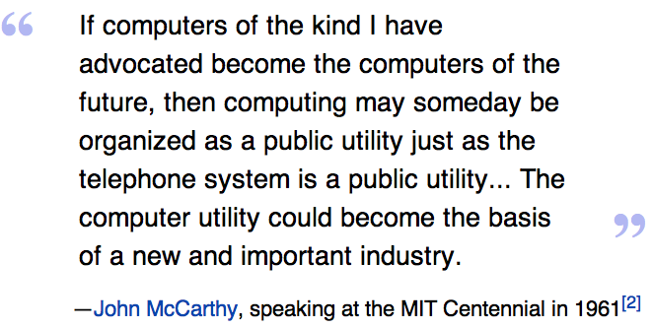
Cloud Computing: History

Slide 6
Cloud Computing: Why Now?
Experience with very large datacenters
Unprecedented economies of scale
Transfer of risk
Technology factors
Pervasive broadband Internet
Maturity in Virtualization Technology
Business factors
Minimal capital expenditure
Pay-as-you-go billing model

Slide 7
Economics of Cloud Users
Pay by use instead of provisioning for peak
Capacity
Resources
Resources
Demand
Capacity
Demand
Time
Time
Static data center
Data center in the cloud
Unused resources
Slide Credits: Berkeley RAD Lab

Slide 8
Economics of Cloud Users
Risk of over-provisioning: underutilization
Capacity
Unused resources
Resources
Demand
Time
Static data center
Slide Credits: Berkeley RAD Lab

Slide 9
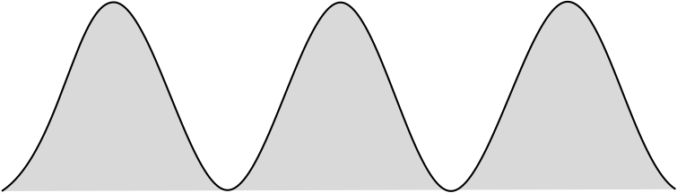
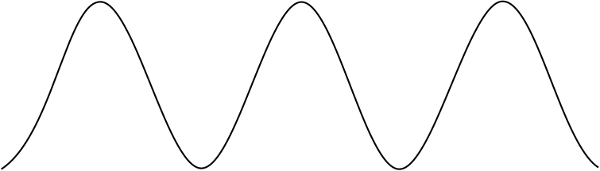
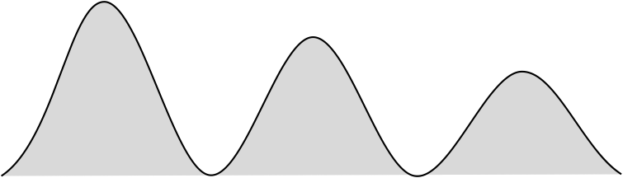

Economics of Cloud Users
Heavy penalty for under-provisioning
Resources
Capacity
Resources
Demand
Capacity
1
2
3
Time (days)
Demand
Lost revenue
1
2
3
Time (days)
Resources
Capacity
Demand
1
2
3
Time (days)
Lost users
Slide Credits: Berkeley RAD Lab

Slide 10
The Big Picture
Unlike the earlier attempts:
Distributed Computing
Distributed Databases
Grid Computing
Cloud Computing is likely to persist:
Organic growth: Google, Yahoo, Microsoft, and Amazon
Poised to be an integral aspect of National Infrastructure in US and other countries

Slide 11
Cloud Reality
Facebook Generation of Application Developers
Animoto.com:
Started with 50 servers on Amazon EC2
Growth of 25,000 users/hour
Needed to scale to 3,500 servers in 2 days (RightScale@SantaBarbara)
Many similar stories:
RightScale
Joyent
…

Slide 12
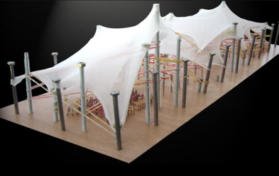
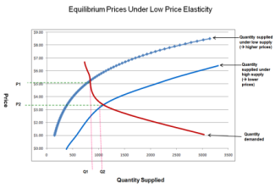


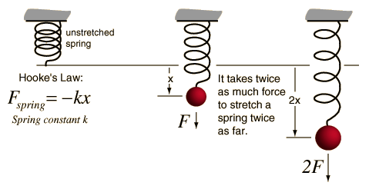
Cloud Challenges: Elasticity

Slide 13

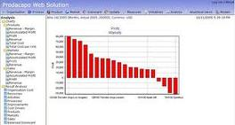

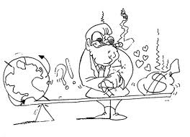
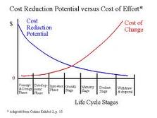
Cloud Challenges: Differential Pricing Models

Slide 14
Outline
Data in the Cloud
Platforms for Data Analysis
Platforms for Update intensive workloads
Data Platforms for Large Applications
Multitenant Data Platforms
Open Research Challenges

Slide 15
Our Data-driven World
Science
Data bases from astronomy, genomics, environmental data, transportation data, …
Humanities and Social Sciences
Scanned books, historical documents, social interactions data, …
Business & Commerce
Corporate sales, stock market transactions, census, airline traffic, …
Entertainment
Internet images, Hollywood movies, MP3 files, …
Medicine
MRI & CT scans, patient records, …

Slide 16
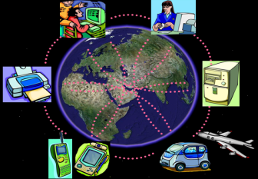
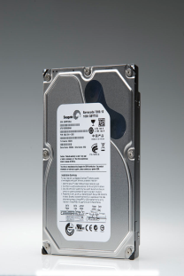

Data-rich World
Data capture and collection:
Highly instrumented environment
Sensors and Smart Devices
Network
Data storage:
Seagate 1 TB Barracuda @ $72.95 from Amazon.com (73¢/GB)

Slide 17

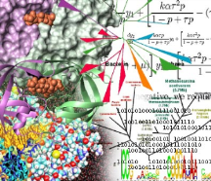

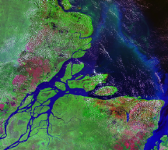
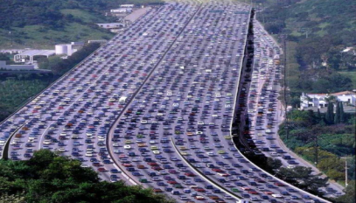

What can we do with this wealth?
What can we do?
Scientific breakthroughs
Business process efficiencies
Realistic special effects
Improve quality-of-life: healthcare, transportation, environmental disasters, daily life, …
Could We Do More?
YES: but need major advances in our capability to analyze this data

Slide 18


Cloud Computing Modalities
“Can we outsource our IT software and hardware infrastructure?”
“We have terabytes of click-stream data – what can we do with it?”
Hosted Applications and services
Pay-as-you-go model
Scalability, fault-tolerance, elasticity, and self-manageability
Very large data repositories
Complex analysis
Distributed and parallel data processing

Slide 19
Outline
Data in the Cloud
Platforms for Data Analysis
Platforms for Update intensive workloads
Data Platforms for Large Applications
Multitenant Data Platforms
Open Research Challenges

Slide 20
Data Warehousing, Data Analytics & Decision Support Systems
Used to manage and control business
Transactional Data: historical or point-in-time
Optimized for inquiry rather than update
Use of the system is loosely defined and can be ad-hoc
Used by managers and analysts to understand the business and make judgments

Slide 21
Data Analytics in the Web Context
Data capture at the user interaction level:
in contrast to the client transaction level in the Enterprise context
As a consequence the amount of data increases significantly
Greater need to analyze such data to understand user behaviors

Slide 22
Data Analytics in the Cloud
Scalability to large data volumes:
Scan 100 TB on 1 node @ 50 MB/sec = 23 days
Scan on 1000-node cluster = 33 minutes
➔ Divide-And-Conquer (i.e., data partitioning)
Cost-efficiency:
Commodity nodes (cheap, but unreliable)
Commodity network
Automatic fault-tolerance (fewer administrators)
Easy to use (fewer programmers)

Slide 23
Platforms for Large-scale Data Analysis
Parallel DBMS technologies
Proposed in the late eighties
Matured over the last two decades
Multi-billion dollar industry: Proprietary DBMS Engines intended as Data Warehousing solutions for very large enterprises
Map Reduce
pioneered by Google
popularized by Yahoo! (Hadoop)

Slide 24
Parallel DBMS technologies
Popularly used for more than two decades
Research Projects: Gamma, Grace, …
Commercial: Multi-billion dollar industry but access to only a privileged few
Relational Data Model
Indexing
Familiar SQL interface
Advanced query optimization
Well understood and well studied

Slide 25
MapReduce [Dean et al., OSDI 2004, CACM Jan 2008, CACM Jan 2010]
Overview:
Data-parallel programming model
An associated parallel and distributed implementation for commodity clusters
Pioneered by Google
Processes 20 PB of data per day
Popularized by open-source Hadoop project
Used by Yahoo!, Facebook, Amazon, and the list is growing …

Slide 26
Programming Framework
Raw Input: <key, value>
MAP
<K1, V1>
<K2,V2>
<K3,V3>
REDUCE

Slide 27
MapReduce Advantages
Automatic Parallelization:
Depending on the size of RAW INPUT DATA ➔ instantiate multiple MAP tasks
Similarly, depending upon the number of intermediate <key, value> partitions ➔ instantiate multiple REDUCE tasks
Run-time:
Data partitioning
Task scheduling
Handling machine failures
Managing inter-machine communication
Completely transparent to the programmer/analyst/user

Slide 28
MapReduce Experience
Runs on large commodity clusters:
1000s to 10,000s of machines
Processes many terabytes of data
Easy to use since run-time complexity hidden from the users
1000s of MR jobs/day at Google (circa 2004)
100s of MR programs implemented (circa 2004)

Slide 29
The Need
Special-purpose programs to process large amounts of data: crawled documents, Web Query Logs, etc.
At Google and others (Yahoo!, Facebook):
Inverted index
Graph structure of the WEB documents
Summaries of #pages/host, set of frequent queries, etc.
Ad Optimization
Spam filtering

Slide 30
MapReduce Contributions
Simple & Powerful
Programming Paradigm
For
Large-scale Data Analysis
Run-time System
For
Large-scale Parallelism & Distribution

Slide 31
Takeaway
MapReduce’s data-parallel programming model hides complexity of distribution and fault tolerance
Key philosophy:
Make it scale, so you can throw hardware at problems
Make it cheap, saving hardware, programmer and administration costs (but requiring fault tolerance)
Hive and Pig further simplify programming
MapReduce is not suitable for all problems, but when it works, it may save you a lot of time

Slide 32
Map Reduce vs Parallel DBMS [Pavlo et al., SIGMOD 2009, Stonebraker et al., CACM 2010, …]
 | Parallel DBMS | MapReduce
Schema Support | ✓ | Not out of the box
Indexing | ✓ | Not out of the box
Programming Model | Declarative (SQL) | Imperative (C/C++, Java, …) Extensions through Pig and Hive
Optimizations (Compression, Query Optimization) | ✓ | Not out of the box
Flexibility | Not out of the box | ✓
Fault Tolerance | Coarse grained techniques | ✓

Slide 33

MapReduce: A step backwards?
Don’t need 1000 nodes to process petabytes:
Parallel DBs do it in fewer than 100 nodes
No support for schema:
Sharing across multiple MR programs difficult
No indexing:
Wasteful access to unnecessary data
Non-declarative programming model:
Requires highly-skilled programmers
No support for JOINs:
Requires multiple MR phases for the analysis

Slide 34
MapReduce VS Parallel DB: Our 2¢
Web application data is inherently distributed on a large number of sites:
Funneling data to DB nodes is a failed strategy
Distributed and parallel programs difficult to develop:
Failures and dynamics in the cloud
Indexing:
Sequential Disk access 10 times faster than random access.
Not clear if indexing is the right strategy.
Complex queries:
DB community needs to JOIN hands with MR

Slide 35
Leveraging DBMS Technology for Scalable Analytics

Slide 36
Scalable Analytics Innovations
Asynchronous Views over Cloud Data
Yahoo! Research (SIGMOD’2009)
DataPath: Data-centric Analytic Engine
U Florida (Dobra) & Rice (Jermaine) (SIGMOD’2010)
MapReduce innovations:
MapReduce Online (UCBerkeley)
HadoopDB (Yale)
Multi-way Join in MapReduce (Afrati&Ullman: EDBT’2010)
Hadoop++ (Dittrich et al.: VLDB’2010) and others

Slide 37
Key-value Stores
Data-stores for Web applications & analytics:
PNUTS, BigTable, Dynamo, …
Massive scale:
Scalability, Elasticity, Fault-tolerance, & Performance
Weak consistency
ACID
Simple queries
Not-so-simple queries
SQL
Views over Key-value Stores

Slide 38
Simple to Not-so-simple Queries
Simple
Not-so-simple
SQL
0
Primary access
Point lookups
Range scans
Secondary access
Joins
Group-by aggregates

Slide 39
Secondary Access
Reviews(review-id,user,item,text)
1 | Dave | TV | …
2 | Jack | GPS | …
4 | Alex | DVD | …
5 | Jack | TV | …
7 | Dave | GPS | …
8 | Tim | TV | …
Reviews for TV
ByItem(item,review-id,user,text)
GPS | 2 | Jack | …
GPS | 7 | Dave | …
TV | 1 | Dave | …
TV | 5 | Jack
TV | 8 | Tim | …
DVD | 4 | Alex | …
View records are replicas with a different primary key
ByItem is a remote view

Slide 40
Remote View Maintenance [Agrawal et al. SIGMOD’2009]
Clients
☺
API
Query Routers
disk write in log
cache write in storage
return to user
flush to disk
remote view maintenance
view log message(s)
view update(s) in storage
Log Managers
f
☺
a
d
b
g
e
g
Storage Servers
Remote Maintainer

Slide 41
Hadoop DB – A Hybrid Approach [Abouzeid et al., VLDB 2009]
An architectural hybrid of MapReduce and DBMS technologies
Use Fault-tolerance and Scale of MapReduce framework like Hadoop
Leverage advanced data processing techniques of an RDBMS
Expose a declarative interface to the user
Goal: Leverage from the best of both worlds

Slide 42
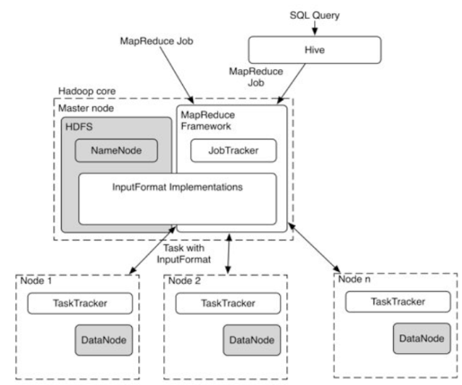
Architecture of HadoopDB

Slide 43
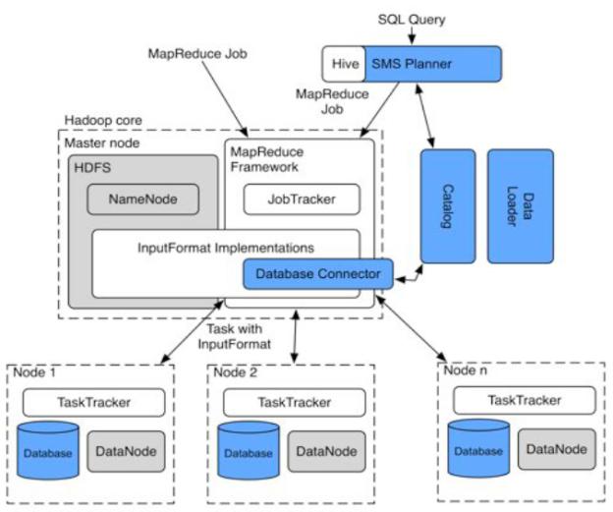
Architecture of HadoopDB

Slide 44
Two-way Joins and MapReduce
MapReduce works with a single data source (table):
<key K, value V>
How to use the MR framework to compute:
R(A, B) S(B, C)
Simple extension (proposed independently by multiple researchers):
<a, b> from R is mapped as: <b, [R, a]>
<b, c> from S is mapped as: <b, [S, c]>
During the reduce phase:
Join the key-value pairs with the same key but different relations

Slide 45
Beyond Two-way Joins?
How to generalize to:
R(A, B) S(B, C) T(C,D)
in MapReduce?

Slide 46
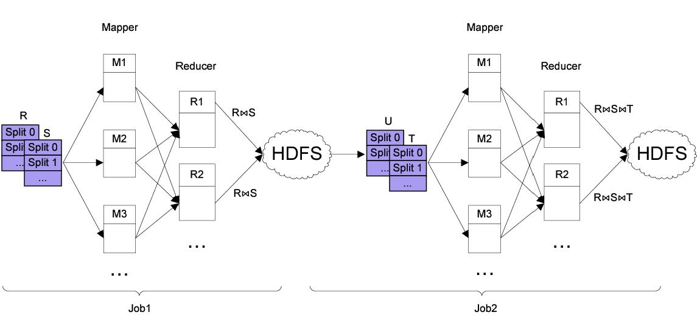
Beyond Two-way Joins
U

Slide 47
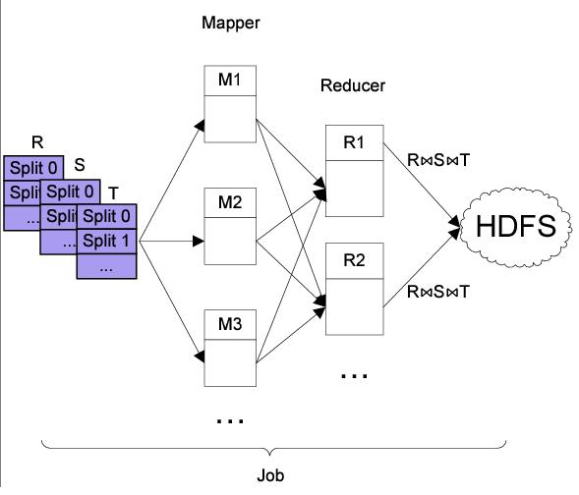
Beyond Two-way Joins?

Slide 48
Multi-way Join [Afrati & Ullman: EDBT’2010]
R(A,B)
S(B,C)
T(C,D)
h(b,c) | 0 | 1 | 2 | 3 | 4 | 5
0
1
2
3
4
5

Slide 49
OLAP over MapReduce
Multi-way Join over a single MR phase:
One-to-many shuffle
Communication cost:
3-way Join: O(n) communication
4-way Join: O(n²)
…
M-way Join: O(n^{M-2})
Clearly, not feasible for OLAP:
Large number of Dimension Tables
Many OLAP queries involve Join of FACT table with multiple Dimension tables.

Slide 50


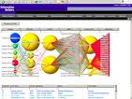

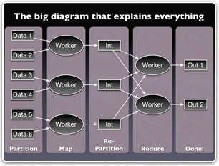


Slide 51
Scalable OLAP [SIGMOD’2011: NUS & UCSB Collaboration]
Observations:
STAR Schema (or its variant)
DIMENSION tables typically are not very large (in most cases)
FACT table, on the other hand, have a large number of rows.
Design approach:
Use MapReduce as a distributed & parallel computing substrate
Fact tables partitioned across multiple nodes
Partitioning strategy should be based on the dimension that are most often used as selection constraint in DW queries
Dimension tables are replicated
MAP tasks perform the STAR joins
REDUCE tasks then perform the aggregation

Slide 52
Data Analytics in the Cloud New Challenges and Opportunities

Slide 53
Looking Forward New Applications
Complex data processing – Graphs and beyond
Multidimensional Data Analytics: Location-based data
Physical and Virtual Worlds: Social Networks and Social Media data & analysis

Slide 54
Conjectures
New breed of Analysts:
Information-savvy users
Most users will become nimble analysts
Most transactional decisions will be preceded by a detailed analysis
Convergence of OLAP and OLTP:
Both from the application point-of-view and from the infrastructure point-of-view

Slide 55
Outline
Data in the Cloud
Platforms for Data Analysis
Platforms for Update intensive workloads
Data Platforms for Large Applications
Multitenant Data Platforms
Open Research Challenges

Slide 56
Platforms for Update intensive workloads
Most enterprise solutions are based on RDBMS technology.
Significant Operational Challenges:
Provisioning for Peak Demand
Resource under-utilization
Capacity planning: too many variables
Storage management: a massive challenge
System upgrades: extremely time-consuming
Complex mine-field of software and hardware licensing
➔ Unproductive use of people-resources from a company’s perspective

Slide 57
Scaling in the Cloud
Client Site
Client Site
Client Site
Load Balancer (Proxy)
App Server
App Server
App Server
App Server
App Server
MySQL Master DB
MySQL Slave DB
Database becomes the Scalability Bottleneck
Cannot leverage elasticity
Replication

Slide 58
Scaling in the Cloud
Client Site
Client Site
Client Site
Load Balancer (Proxy)
App Server
App Server
App Server
App Server
App Server
MySQL Master DB
Replication
MySQL Slave DB

Slide 59



Scaling in the Cloud
Client Site
Client Site
Client Site
Load Balancer (Proxy)
Apache
+ App Server
Apache
+ App Server
Apache
+ App Server
Apache
+ App Server
Apache
+ App Server
Scalable and Elastic,
but limited consistency and operational flexibility
Key Value Stores

Slide 60
BLOG Wisdom
“If you want vast, on-demand scalability, you need a non-relational database.” Since scalability requirements:
Can change very quickly and,
Can grow very rapidly.
Difficult to manage with a single in-house RDBMS server.
RDBMS scale well:
When limited to a single node, but
Overwhelming complexity to scale on multiple server nodes.

Slide 61
The “NoSQL” movement
Initially used for: “Open-Source relational database that did not expose SQL interface”
Popularly used for: “non-relational, distributed data stores that often did not attempt to provide ACID guarantees”
Gained widespread popularity through a number of open source projects
HBase, Cassandra, Voldemort, MongDB, …
Scale-out, elasticity, flexible data model, high availability

Slide 62
NoSQL has no relation with SQL - Micheal Stonebraker [CACM Blog]
Term heavily used (and abused)
Scalability and performance bottleneck not inherent to SQL
Scale-out, auto-partitioning, self-manageability can be achieved with SQL
Different implementations of SQL engine for different application needs
SQL provides flexibility, portability

Slide 63
No-SQL ➔ Not Only SQL
Recently renamed
Encompass a broad category of “structured” storage solutions
RDBMS is a subset
Key Value stores
Document stores
Graph database
The debate on appropriate characterization continues

Slide 64
Cloud Data Management Desiderata SQL or NoSQL
Scalability
Elasticity
Fault tolerance
Self Manageability
Sacrifice consistency?

Slide 65
Sacrificing Consistency Increased Application Complexity
public void confirm_friend_request(user1, user2)
{
begin_transaction();
update_friend_list(user1, user2, status.confirmed);
//Palo Alto update_friend_list(user2, user1, status.confirmed);
//London
end_transaction();
}

Slide 66
public void confirm_friend_request_A(user1, user2){
try{ update_friend_list(user1, user2, status.confirmed); //palo alto }
catch(exception e){ report_error(e); return; }
try{ update_friend_list(user2, user1, status.confirmed); //london }
catch(exception e) { revert_friend_list(user1, user2); report_error(e); return; }
}

Slide 67
public void confirm_friend_request_B(user1, user2){
try{ update_friend_list(user1, user2, status.confirmed); //palo alto }catch(exception e){ report_error(e); add_to_retry_queue(operation.updatefriendlist, user1, user2, current_time()); }
try{ update_friend_list(user2, user1, status.confirmed); //london }catch(exception e) { report_error(e); add_to_retry_queue(operation.updatefriendlist, user2, user1, current_time()); } }

Slide 68
/* get_friends() method has to reconcile results returned by get_friends() because there may be data inconsistency due to a conflict because a change that was applied from the message queue is contradictory to a subsequent change by the user. In this case, status is a bitflag where all conflicts are merged and it is up to app developer to figure out what to do. */
public list get_friends(user1){ list actual_friends = new list(); list friends = get_friends(); foreach (friend in friends){ if(friend.status == friendstatus.confirmed){ //no conflict actual_friends.add(friend); }else if((friend.status &= friendstatus.confirmed) and !(friend.status &= friendstatus.deleted)){ // assume friend is confirmed as long as it wasn’t also deleted friend.status = friendstatus.confirmed; actual_friends.add(friend); update_friends_list(user1, friend, status.confirmed); }else{ //assume deleted if there is a conflict with a delete update_friends_list( user1, friend, status.deleted) } }//foreach return actual_friends; }
It gets too complicated with Eventual Consistency

Slide 69

Perspectives (James Hamilton)
I love eventual consistency but there are some applications that are much easier to implement with strong consistency. Many like eventual consistency because it allows us to scale-out nearly without bound but it does come with a cost in programming model complexity.
February 24, 2010

Slide 70
Quest for Scalable, Fault-tolerant, and Consistent Data Management in the Cloud that provides
Elasticity

Slide 71
Outline
Data in the Cloud
Data Platforms for Large Applications
Key value Stores
Transactional support in the cloud
Multitenant Data Platforms
Concluding Remarks

Slide 72
Key Value Stores
Key-Valued data model
Key is the unique identifier
Key is the granularity for consistent access
Value can be structured or unstructured
Gained widespread popularity
In house: Bigtable (Google), PNUTS (Yahoo!), Dynamo (Amazon)
Open source: HBase, Hypertable, Cassandra, Voldemort
Popular choice for the modern breed of web-applications

Slide 73
Important Design Goals
Scale out: designed for scale
Commodity hardware
Low latency updates
Sustain high update/insert throughput
Elasticity – scale up and down with load
High availability – downtime implies lost revenue
Replication (with multi-mastering)
Geographic replication
Automated failure recovery

Slide 74
Lower Priorities
No Complex querying functionality
No support for SQL
CRUD operations through database specific API
No support for joins
Materialize simple join results in the relevant row
Give up normalization of data?
No support for transactions
Most data stores support single row transactions
Tunable consistency and availability (e.g., Dynamo)
➔ Achieve high scalability

Slide 75
Interplay with CAP
Consistency, Availability, and Network Partitions
Only have two of the three together
Large scale operations – be prepared for network partitions
Role of CAP – During a network partition, choose between Consistency and Availability
RDBMS choose consistency
Key Value stores choose availability [low replica consistency]

Slide 76
Why sacrifice Consistency?
It is a simple solution
nobody understands what sacrificing P means
sacrificing A is unacceptable in the Web
possible to push the problem to app developer
C not needed in many applications
Banks do not implement ACID (classic example wrong)
Airline reservation only transacts reads (Huh?)
MySQL et al. ship by default in lower isolation level
Data is noisy and inconsistent anyway
making it, say, 1% worse does not matter
[Vogels, VLDB 2007]

Slide 77
C and A: In a Network Partition
Dynamo – quorum based replication
Multi-mastering keys – Eventual Consistency
Tunable read and write quorums
Larger quorums – higher consistency, lower availability
Vector clocks to allow application supported reconciliation
PNUTS – log based replication
Similar to log replay – reliable log multicast
Per record mastering – timeline consistency
Major outage might result in losing the tail of the log

Slide 78
Too many choices – Which system should I use?

Slide 79
Benchmarking Serving Systems [Cooper et al., SOCC 2010]
A standard benchmarking tool for evaluating Key Value stores
Evaluate different systems on common workloads
Focus on performance and scale out

Slide 80
Benchmark tiers
Tier 1 – Performance
Latency versus throughput as throughput increases
Tier 2 – Scalability
Latency as database, system size increases
“Scale-out”
Latency as we elastically add servers
“Elastic speedup”

Slide 81
Workload A – Update heavy
50/50 Read/update

Slide 82
Workload B – Read heavy
95/5 Read/update

Slide 83
Workload E – short scans
Scans of 1-100 records of size 1KB

Slide 84
Summary
Different databases suitable for different workloads
Evolving systems – landscape changing dramatically
Active development community around open source systems

Slide 85
Coffee Break

Slide 86
References
[Dean et al., ODSI 2004] MapReduce: Simplified Data Processing on Large Clusters, J. Dean, S. Ghemawat, In OSDI 2004
[Dean et al., CACM 2008] MapReduce: Simplified Data Processing on Large Clusters, J. Dean, S. Ghemawat, In CACM Jan 2008
[Dean et al., CACM 2010] MapReduce: a flexible data processing tool, J. Dean, S. Ghemawat, In CACM Jan 2010
[Stonebraker et al., CACM 2010] MapReduce and parallel DBMSs: friends or foes?, M. Stonebraker, D. J. Abadi, D. J. DeWitt, S. Madden, E. Paulson, A. Pavlo, A, Rasin, In CACM Jan 2010
[Pavlo et al., SIGMOD 2009] A comparison of approaches to large-scale data analysis, A. Pavlo et al., In SIGMOD 2009
[Abouzeid et al., VLDB 2009] HadoopDB: An Architectural Hybrid of MapReduce and DBMS Technologies for Analytical Workloads, A. Abouzeid et al., In VLDB 2009
[Afrati et al., EDBT 2010] Optimizing joins in a map-reduce environment, F. N. Afrati, J. D. Ullman, In EDBT 2010
[Agrawal et al., SIGMOD 2009] Asynchronous view maintenance for VLSD databases, P. Agrawal et al., In SIGMOD 2009
[Das et al., SIGMOD 2010] Ricardo: Integrating R and Hadoop, S. Das et al., In SIGMOD 2010
[Cohen et al., VLDB 2009] MAD Skills: New Analysis Practices for Big Data, J. Cohen et al., In VLDB 2009

